Slide 1
Introduction to statistics, experimental design and hypothesis testing
Michela Traglia and Reuben Thomas
Bioinformatics Core, GIDB
Gladstone Institutes
January 17, 2023

Slide 2
Introductions
Michela Traglia
Statistician III
Reuben Thomas
Associate Core Director

Slide 3
Motivation of the workshop
Accessible statistical tools allow researcher to easily perform analyses
How the program work and which setting to use?
How to interpret the results?
Hard to get defensible conclusions
Understand and critically evaluate scientific publications
Before the statistical analysis, fundamental is to plan the experimental design

Slide 4
Goals of this workshop
Introduce basic concepts underpinning experimental design
Learn how to think critically about the data you want to generate and use to make claims about
Overview of statistical tests and concepts
Basic level course - No prerequisites
Please feel free to interrupt with questions, speak up or use the chat!

Slide 5
Workshop sessions
Day 1 – Experimental design (Michela Traglia)
Day 2 – Hypothesis testing (Reuben Thomas)
Day 3 – Overview of the statistical analysis (Reuben Thomas)

Slide 6
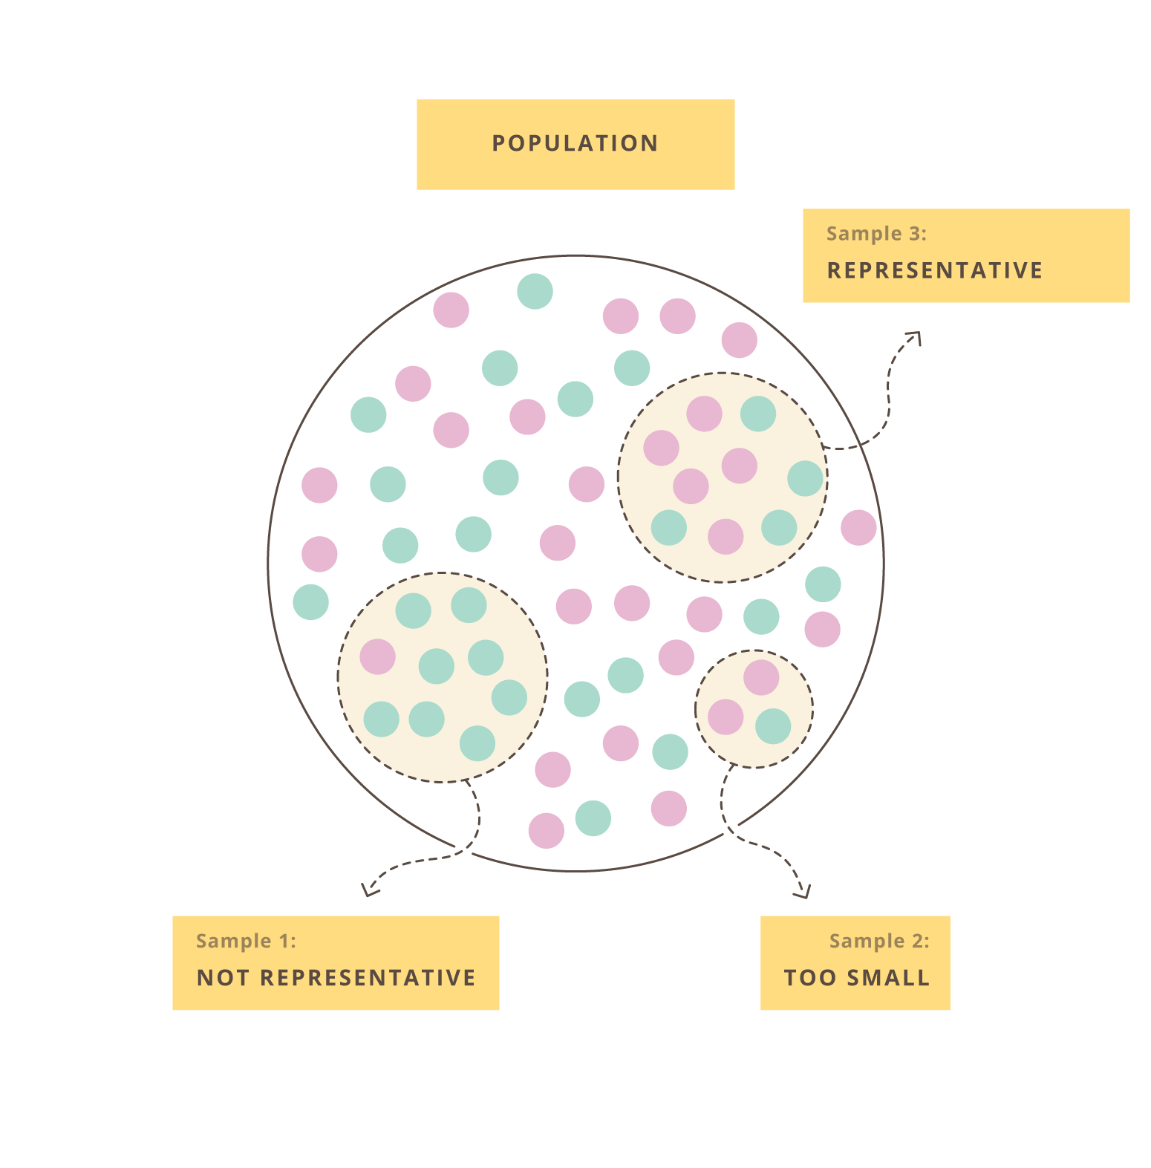
When we perform and experiment…
Empirical data are noisy
Resources are limited
Generalize our scientific claims as much as possible

Slide 7
Statistics is defined as
the science of collecting, analyzing, and drawing conclusions from data

Slide 8
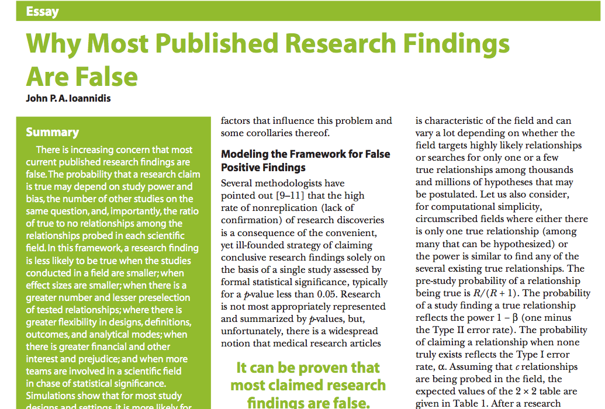
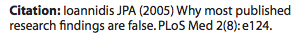

Slide 9
Thanks: Kevin Mullane
Director, Corporate Liaison & Ventures
Corporate Ventures and Translation
Gladstone Institutes
https://gladstone.org/events?series=responsible-conduct-of-research
https://rcr.ucsf.edu/

Slide 10
What we mean with ‘experimental design’
The organization of an experiment, to ensure that the right type of data, and enough of it, is available to answer the questions of interest as clearly and efficiently as possible.
Because the validity of an experiment is directly affected by its construction and execution, attention to experimental design is extremely important.

Slide 11
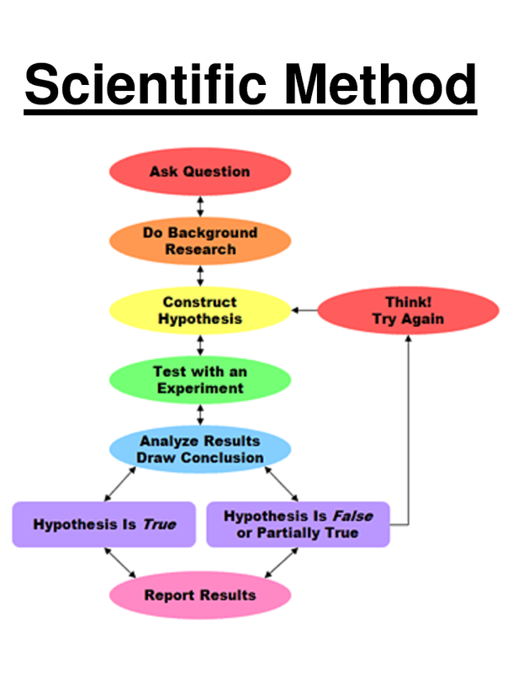
Statistical experimental designs
The scientific method consists of iterative application of the following steps:
observing of the state of nature
(2) hypothesizing the mechanism for what has been observed
(3) collecting data
(4) analyzing the data to confirm or reject the hypothesis
Statistical experimental designs provide a plan for collecting data in a way that they can be analyzed statistically to corroborate the conjecture in question.

Slide 12
Outline of experimental design principles
Define the research questions
Understanding the system you want to study
Formulate your null and alternative hypothesis
Independent and dependent variables of interest
Target population, sampling, replicates
Confounding variables
Break 5 minutes
Assign treatment to groups
Batch effects

Slide 13
1. Define the research question
A specific issue, contradiction between two or more perspectives, or a gap in knowledge that you will aim to address in your research.
What is a scientific question that you are currently working on?

Slide 14
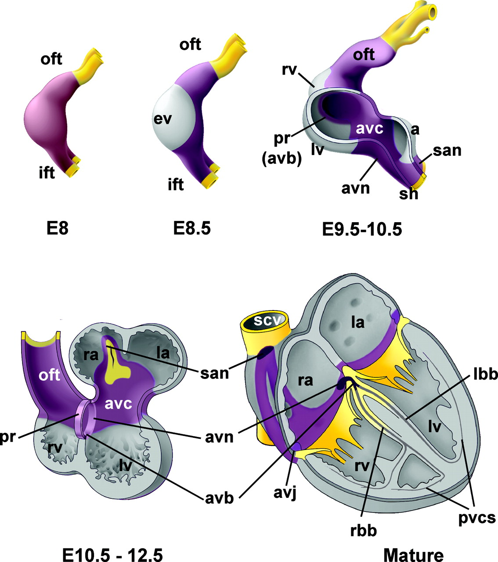
Research question 1
Gene controlling developing heart
https://www.ahajournals.org/doi/epub/10.1161/CIRCEP.108.829341

Slide 15
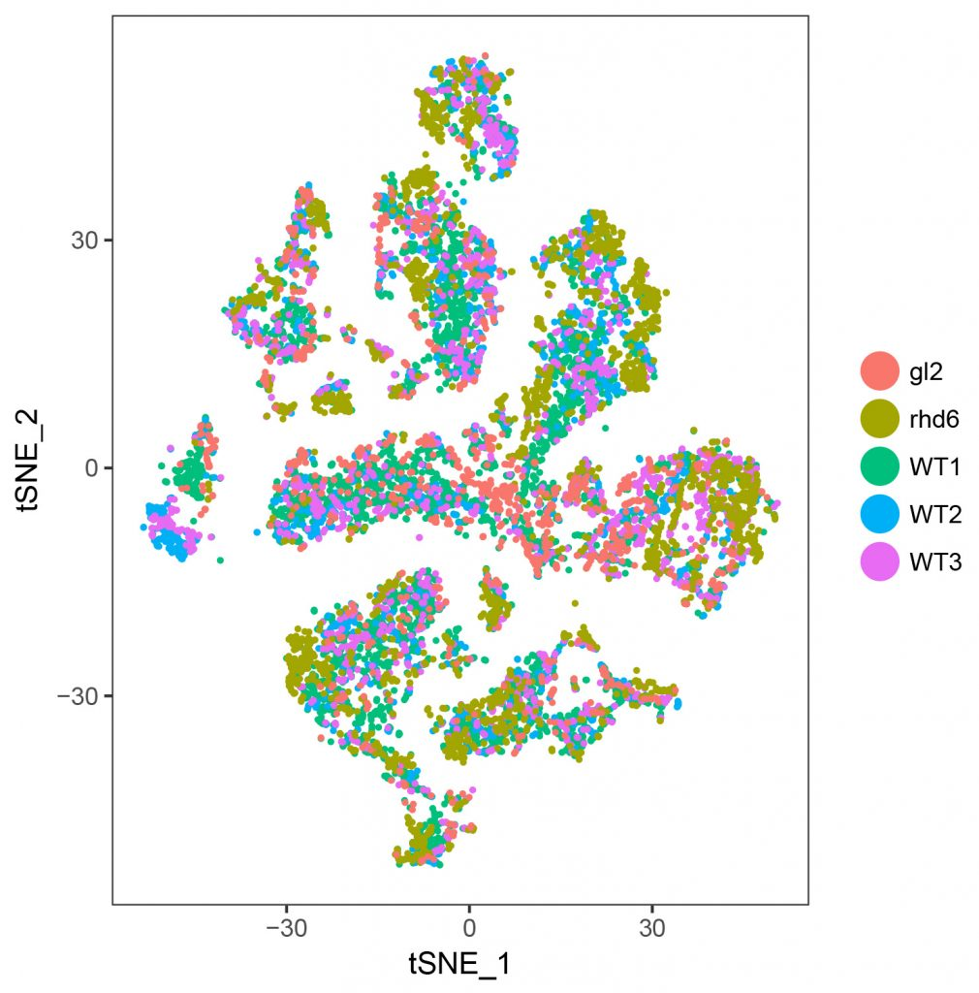
scRNA-seq on cells from WT and mutant mice
Research question 2
mut1
mut2
WT
WT
WT

Slide 16



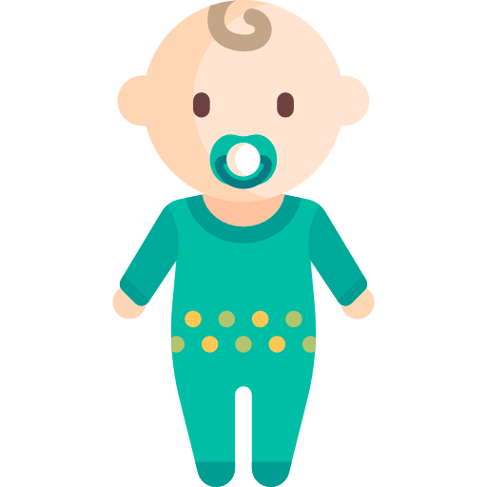
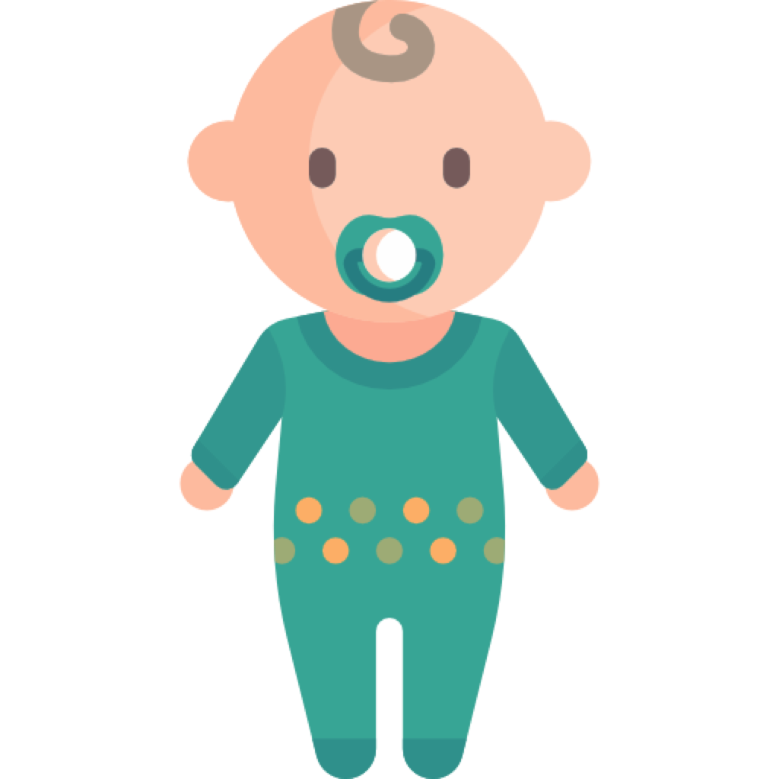
Chemical pollutants during pregnancy contributing to autism in children
Research question 3
CONTROL
ASD CASE
Lyall et al, Environ Health Perspect 2017

Slide 17
Do the pregnant women with more chemical pollutants in the blood have more autistic children?
Ask a specific question
CONTROL
ASD CASE
Lyall et al, Environ Health Perspect 2017

Slide 18
2. Understand the system you are going to study
Observational studies
Experimental studies
Researchers don’t assign exposure
Observing what is already happening
No establishing cause-effect
Ex. Case-controls, cohort
Researchers manipulate factors
Create a treatment and compare the response
Changes cause an effect
Ex.Clinical trials

Slide 19
3. Formulate your hypothesis
The amount of chemical pollutants in the blood of pregnant women negatively affect the fetal brain development and increase the risk of autism in children.
The mother exposed to more pollutants will have more autistic children than mother less exposed to pollutants.
and then write a null and alternative hypothesis
H₀: The pollutants exposure in the blood during pregnancy has no effect on the fetal brain development.
H₁: The pollutants exposure in the blood during pregnancy has a negative effect on the fetal brain development.

Slide 20
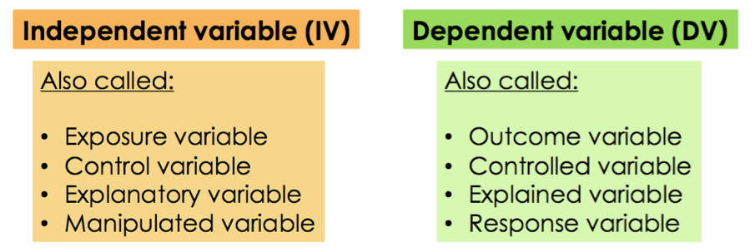
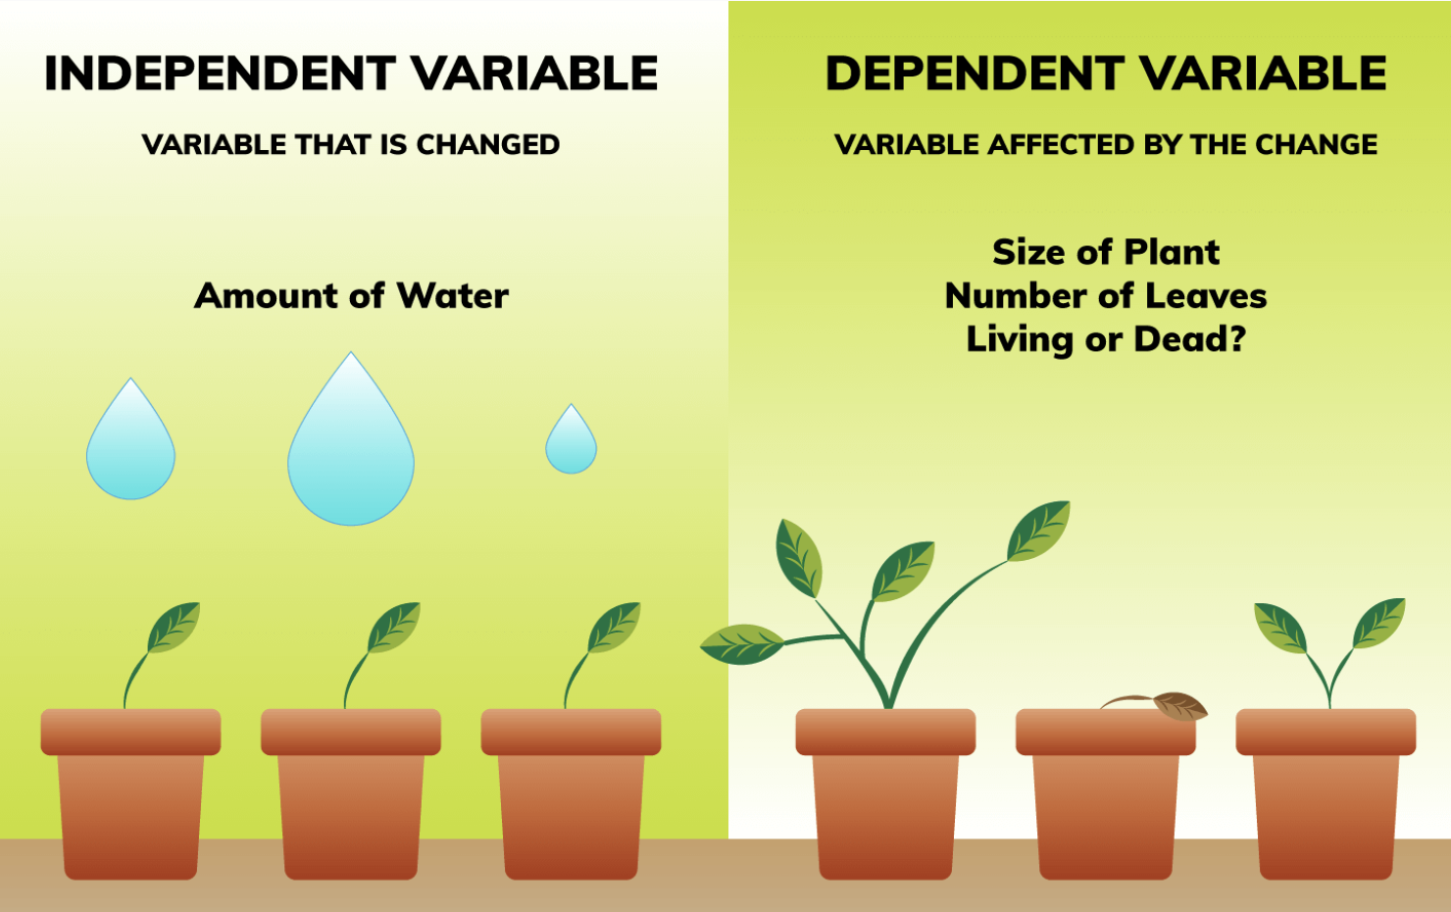
4. Consider the variables of interest
Pollutants measurement
Autism in children
Image source: by Hannah Bonville

Slide 21

Experimental design is used to establish the effect an independent variable has on a dependent variable.
Risk factors
Genotype
X
Disease
Gene expression
Y
In an experiment, you manipulate an independent variable to study its effects on a dependent variable (response)

Slide 22
5. From the population to a sample

Slide 23
Biological and experimental units
Entities to which we apply treatment and on which we make observations and inferences
Animal or human subject
Raw material for some processing operation
Condition that exist at a point in time or trial?
Experimental units are the smallest entities that can be independently assigned to a treatment (e.g., animal, litter, cage, well).

Slide 24
Experimental design guides in
Collecting the maximum volume of relevant and required data for the subject of the research, at minimum resource spend.
Evaluating the source of variations, variables/factors that affect the system.
It is an efficient method to minimize the number of experiments and gather the maximum amount of appropriate data.

Slide 25
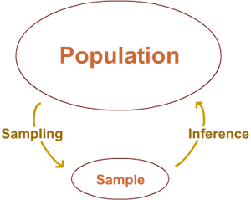
Target population - generalization
All subjects/units that we want base our claims/conclusions on
The cardiac tissue of all mice at embryonic stage E9.5
All children below 5 years old who are diagnosed with autism
All mother that were pregnant in a geographical area
Data is expensive
Studying of the sample ➔ Conclusion on the population

Slide 26
Sample size
As always, it depends…
on what we want to do (differential gene expression, variant detection, GWAS, …)
on the variability between samples (cell lines, inbred animals, patients, …)
on the magnitude of the expected effect

Slide 27
Is a larger sample sizes always better?
Sample size -> amount of information -> precision (margin of error) / level of confidence in our sample estimates.
High variability -> Greater uncertainty
Larger sample size -> more information -> less uncertainty
+ Greater precision and power
- Cost more time and money
The goal is to collect enough data from a sample to statistically test whether you can reasonably reject the null hypothesis in favor of the alternative hypothesis

Slide 28
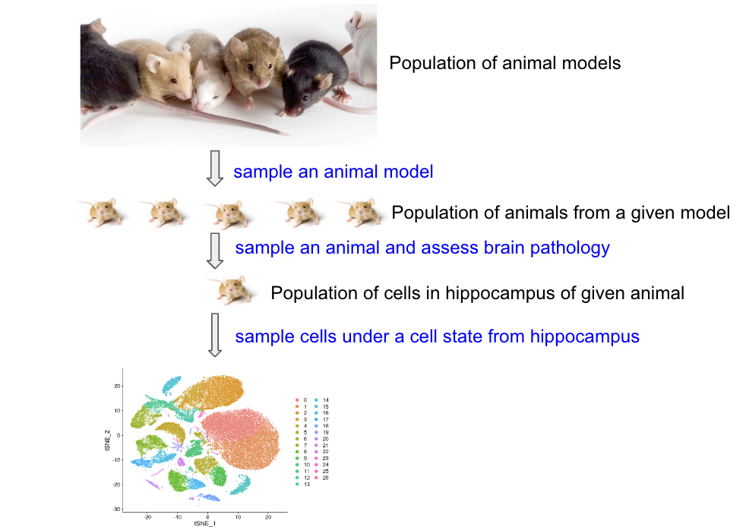
Replicates
scRNA-seq experiment – gene expression differences between WT and mutated mice
H0: ?
H1: ?
Sampling
Population of animal from a given genotype

Slide 29
Replicates – variance estimation
How large differences are you looking for?
What is the expected expression difference of targeted biology in these samples?
Will ”no change” be a desired significant result?
Biological vs technical replicates
Number of replicate runs that will give a high probability of detecting an effect of practical importance
Use biological replicates to answer biological questions, and technical replicates to answer technical questions
Notes:
Learn more about replicates and repeats:https://support.minitab.com/en-us/minitab/18/help-and-how-to/modeling-statistics/doe/supporting-topics/basics/replicates-and-repeats-in-designed-experiments/

Slide 30
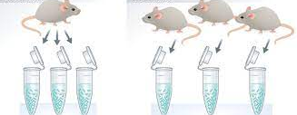
Poll
A
B
Cell cultures have been originated from one mouse (Exp A) and from 3 mice (Exp B). How many biological (n) and technical replicates in experiment A?
n=1 biological and 0 technical replicates
n=1 biological replicate and 3 technical replicates
n=3 biological replicates and 3 technical replicates

Slide 31
Poll
A
B
Cell cultures have been originated from one mouse (Exp A) and from 3 mice (Exp B). What do you have in experiment B?
3 technical replicates
3 biological replicates

Slide 32
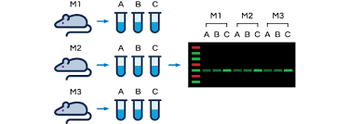
Biological vs technical replicates

Slide 33
How many n?
Do we need to perform a statistical power calculation?
Workshop Day 2 - Reuben Thomas

Slide 34
6. Confounding variables

Slide 35
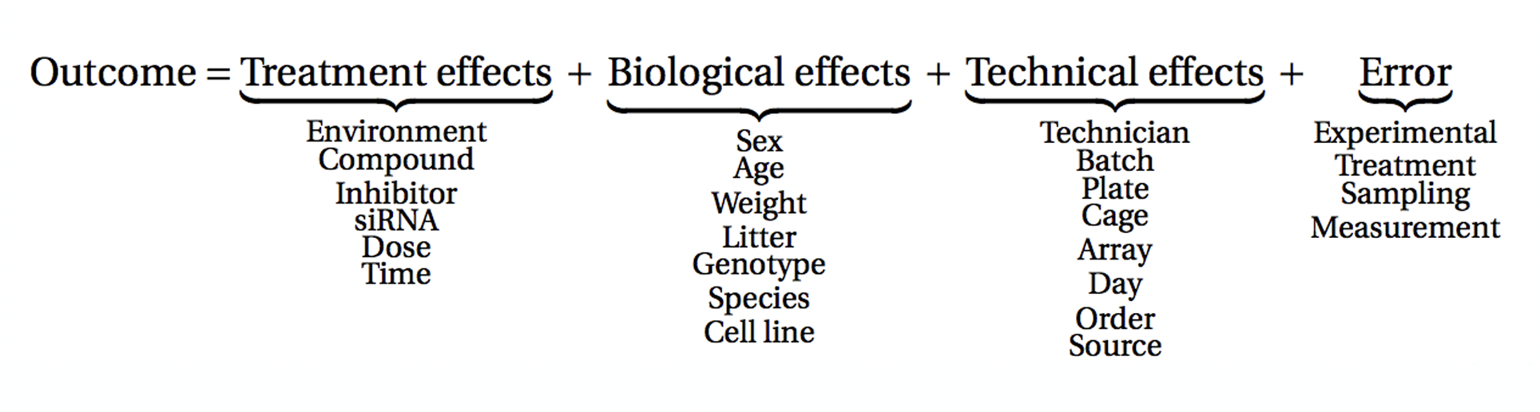
What affects the outcome of an experiment?

Slide 36
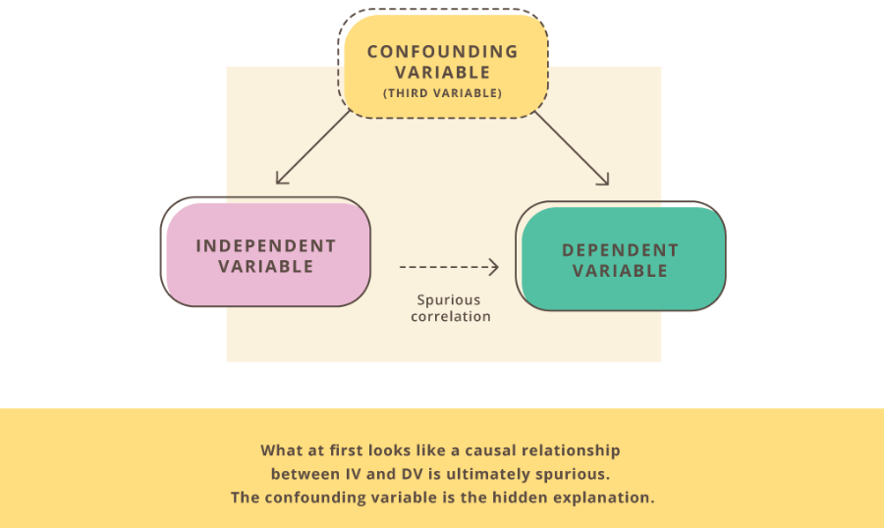
A third variable
A variable that is not included in an experiment, yet affects the relationship between the two variables in an experiment.

Slide 37
Be aware of confounding factors
In observational studies (case-control, cohort studies):
confounding variables could cause unusual interpretations of data and the relationships between variables
In experimental studies:
- design the experiment to eliminate (as much as possible) the risk of confounding variables
Which potential variables could be affecting the relationship between the variables in your study?

Slide 38
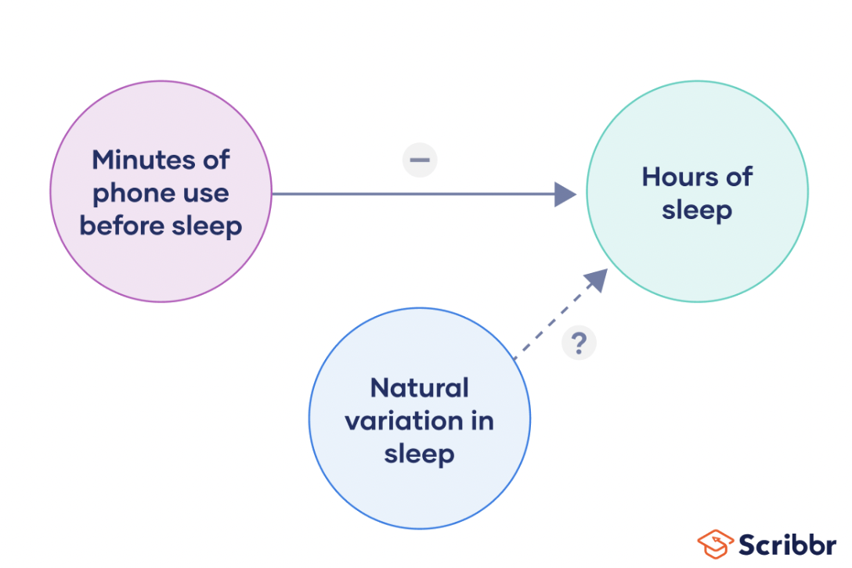
An example…
Independent variable
Outcome, dependent variable
Confounding variable

Slide 39

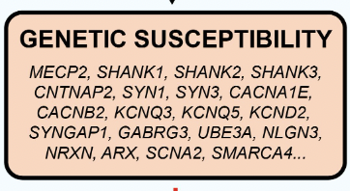
An example…
Independent variable
Outcome, dependent variable
Confounding variable

Slide 40
An example…
Independent variable
Outcome, dependent variable
Confounding variable:
- Ethnicity
- Country of birth
- Genetics

Slide 41
Chemical in pregnant maternal blood correlating with healthy children
Mother with high levels of chemicals blood
Healthy kids
->
Correlation
High chemicals levels – not developing autism
Low chemicals levels – children developing autism
?
Genetics make-up controlling metabolism of chemical

Slide 42
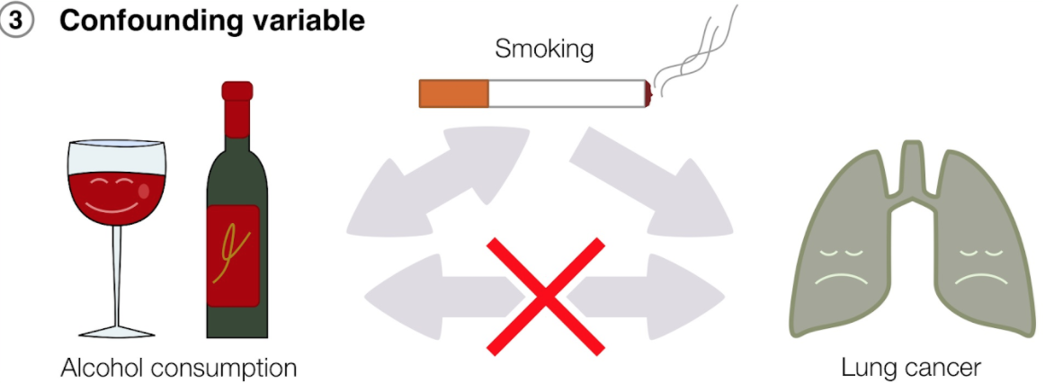
Correlation vs Causation

Slide 43
Poll
Research question: Does light exposure improve learning ability in mice?
What can be the source of variability, confounding the outcome?
Select all that apply
1. Mouse inbred strains
2. Genetic background
3. Learning environment
4. All are ‘independent variables’

Slide 44
Factors potentially affecting the response
Biological factors that could affect the response
-BMI
-ethnicity
-gender
Non-biological or technical factors that could affect the response.
-time/day/month of experiment/batch
-reagents used, reagents batch used
-technician

Slide 45
Considerations about confounding variables
Must be correlated with the independent variable.
Must have a causal relationship with the dependent variable.
Can make it seem that cause-and-effect relationships exist when they don’t.
Can mask the true cause-and-effect relationship between variables.
When confounding variables are present, we can’t always say with complete confidence that the changes we observe in the dependent variable are a direct result of changes in the independent variable.

Slide 46
Break ~ 5 minutes
Please take the survey:
https://www.surveymonkey.com/r/DY7K5ZY

Slide 47
Outline of experimental design principles
Define the research questions
Understanding the system you want to study
Formulate your null and alternative hypothesis
Independent and dependent variables of interest
Target population, sampling, replicates
Confounding variables
Assign treatment to groups
Batch effects

Slide 48
Knowing how to deal with the challenges of experimental design is central to achieving reproducible experiments.

Slide 49
Capture effects of interest and avoid unwanted variation in experiment
Identify the response and variables of interest
Identify target population that you want to base your claims on
Identify factors that affect the response of interest
Choose samples from target population
When well-designed, experiments minimize any bias in this comparison to make stronger inferences about the differences we see in the experiment.

Slide 50
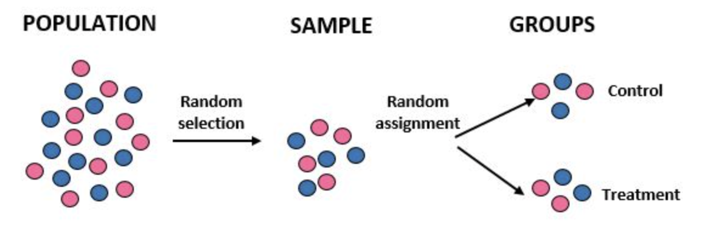
7. Assign treatment to groups

Slide 51
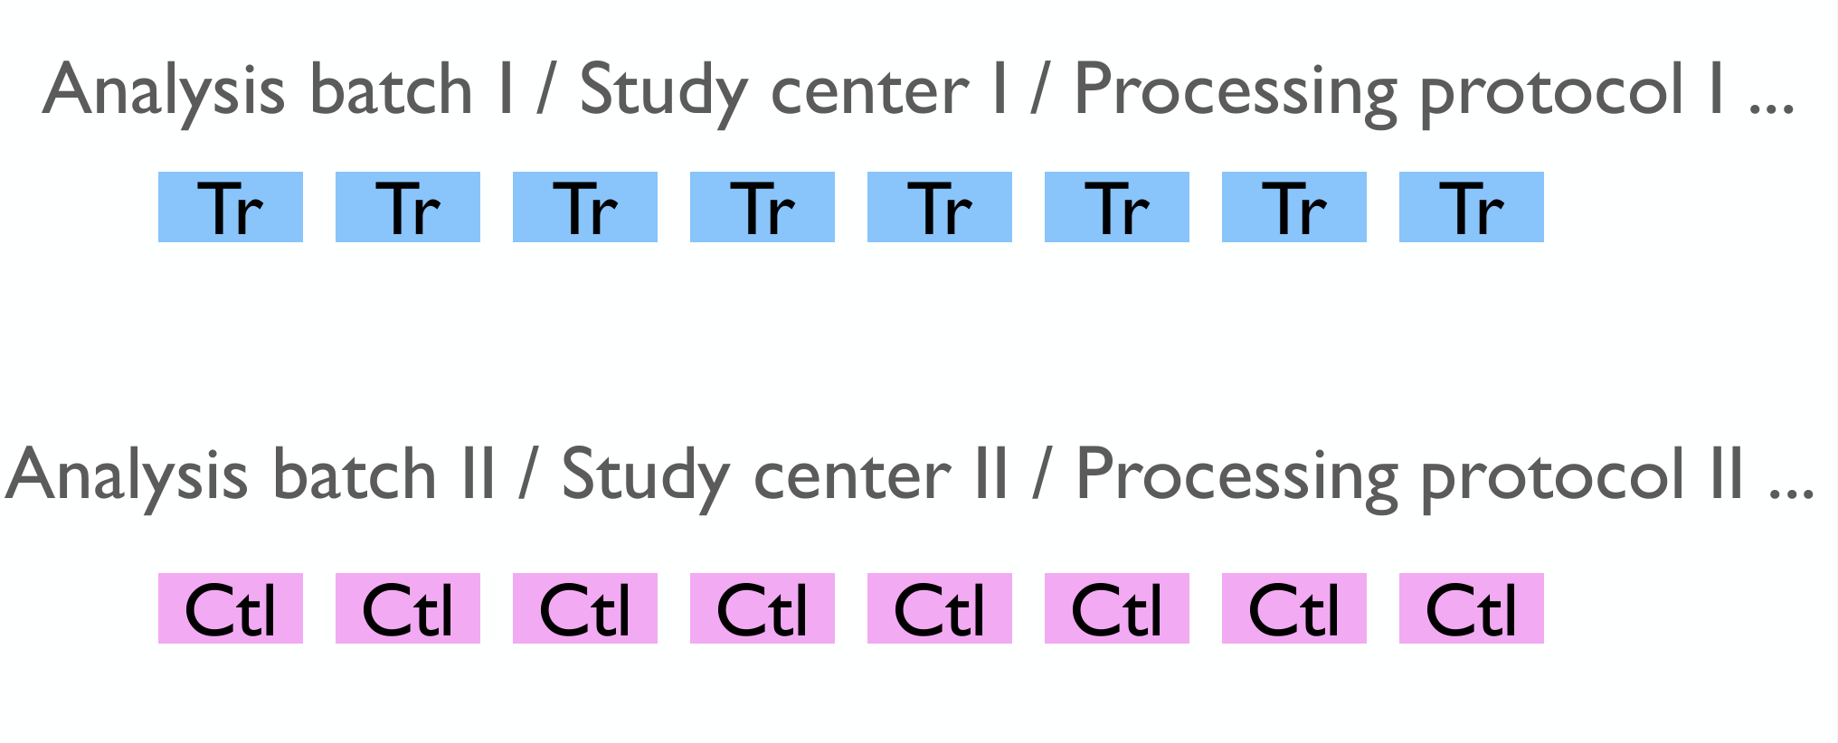
Is this a good assignment?

Slide 52
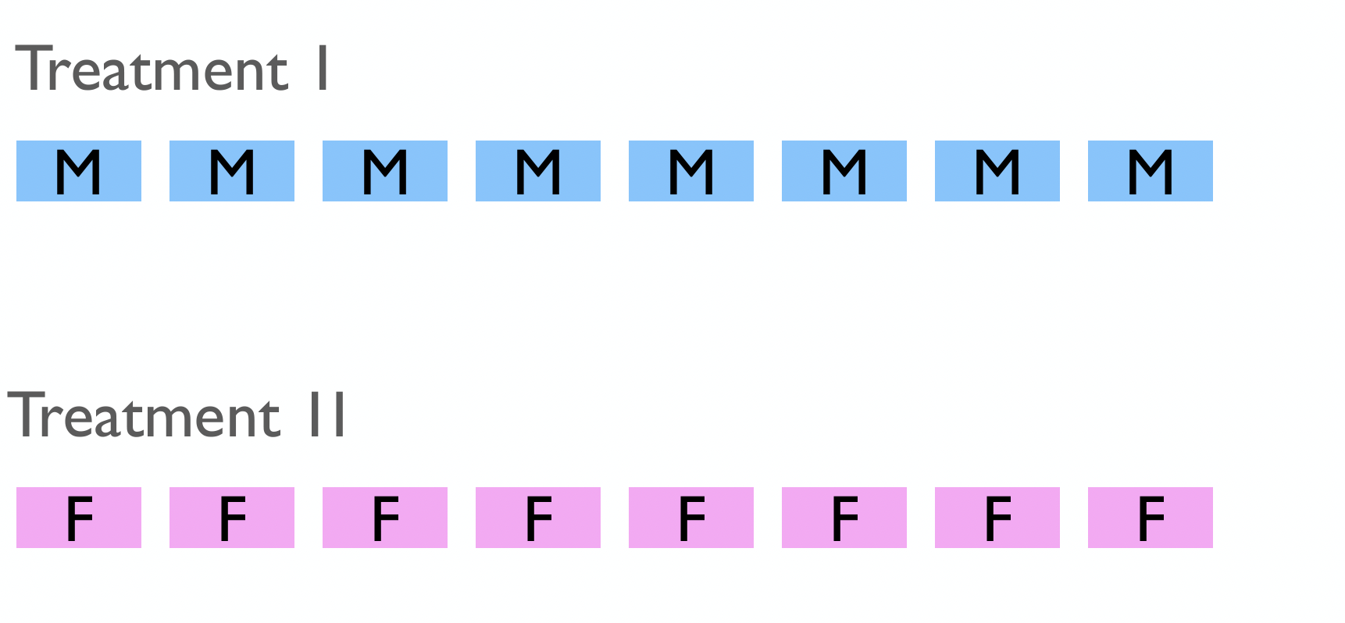

Slide 53
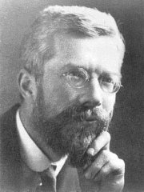
Ronald Fisher
Overcome the large amount of variation in agricultural and biological experiments that often confused the results
This motivated him to find experimental techniques that could
eliminate as much of the natural variation as possible
prevent unremoved variation from confusing or biasing the effects being tested
detect cause and effect with the minimal amount of experimental effort necessary - time consuming and costly
1920 CE, Design of Experiments

Slide 54
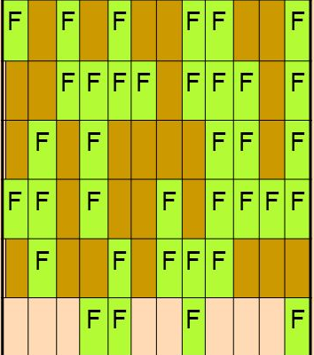
Randomization
Fisher -> helps to avoid confusion or biases due to changes in background or confounding variables.
One of the main purposes for experimental designs is to minimize the effect of experimental error.
Randomization, replication, and blocking, are methods of error control.
Well-designed experiments are characterized by three features: randomization, replication, and local control.

Slide 55
Randomization
Randomly assign subjects to treatment and control groups in order to minimize bias and moderate experimental error.
Assign random numbers to experimental so that any experimental unit (EU) has equal chances of being assigned to treatment or control (for example, odd-numbered EU in the treatment group, and even-numbered EU in the control group).
Can create unequal numbers between treatment and control groups.
Appropriate only for experiments with homogeneous experimental units (e.g., mice should be of same sex, strain, age, etc.) where environmental effects, such as light or temperature, are relatively easy to control.

Slide 56
Blocking
A rack of many mice cages is heterogeneous with respect to light exposure.
The rack of cages can be divided into smaller blocks such that cages within each block tend to be more homogeneous (have equal light exposure).
Blocking approach helps to reduce variability unexplained in the model

Slide 57
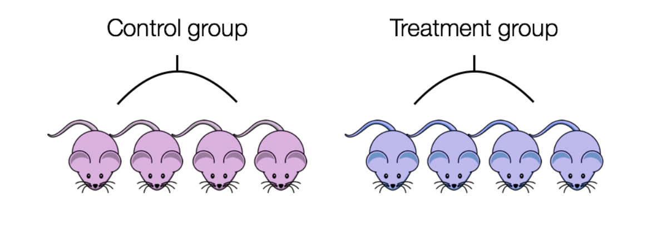
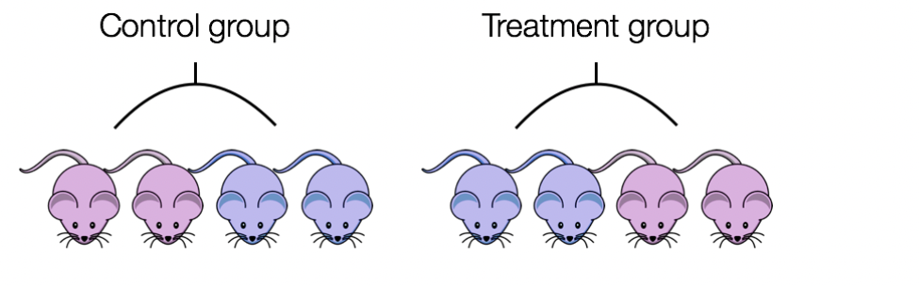
Blocking
If all control mice were female and all of the treatment mice were male, then the treatment effect would be confounded by sex.
Ensure animals in each condition are all the same age, sex, litter and batch, if possible.
If not, split animals equally between conditions.

Slide 58
Capture effects of interest and avoid unwanted variation in experiment
Identify the response and variables of interest
Identify target population that you want to base your claims on
Identify factors that affect the response of interest
Choose samples from target population
Randomly assign samples across different levels of factors affecting response
Block out variation that is not of interest by randomly assigning to levels of factors within a block

Slide 59
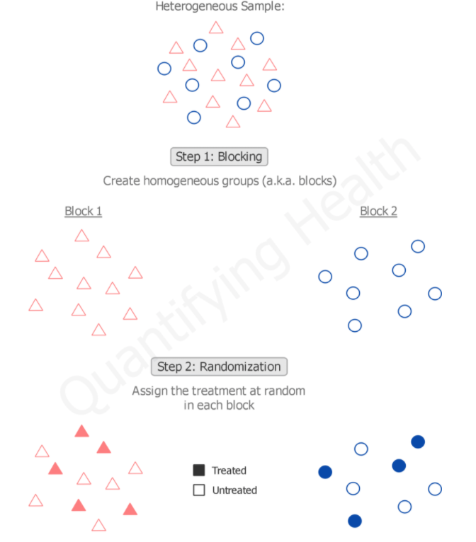
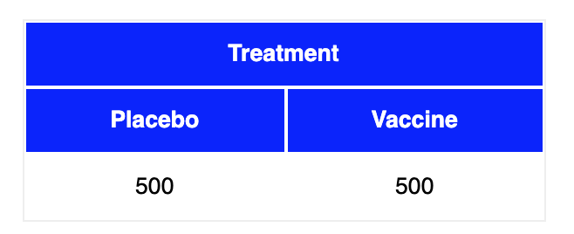
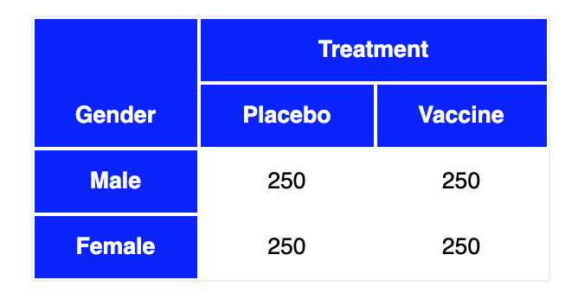
Randomized block design I
https://quantifyinghealth.com/randomized-block-design/
https://stattrek.com/experiments/experimental-design.aspx

Slide 60
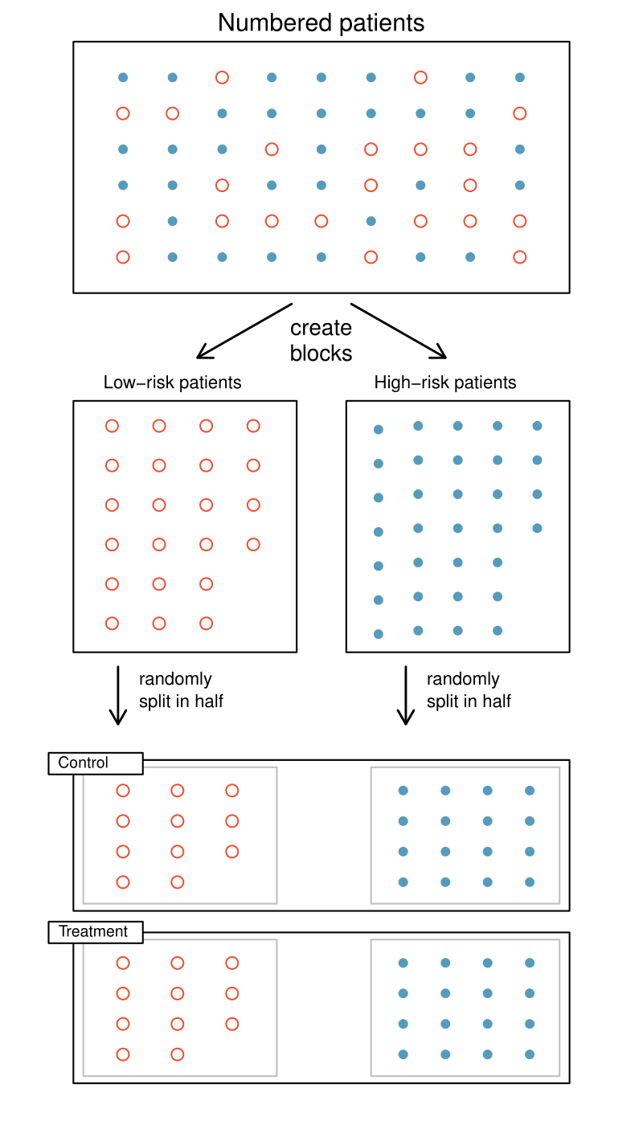
Randomized block design II

Slide 61
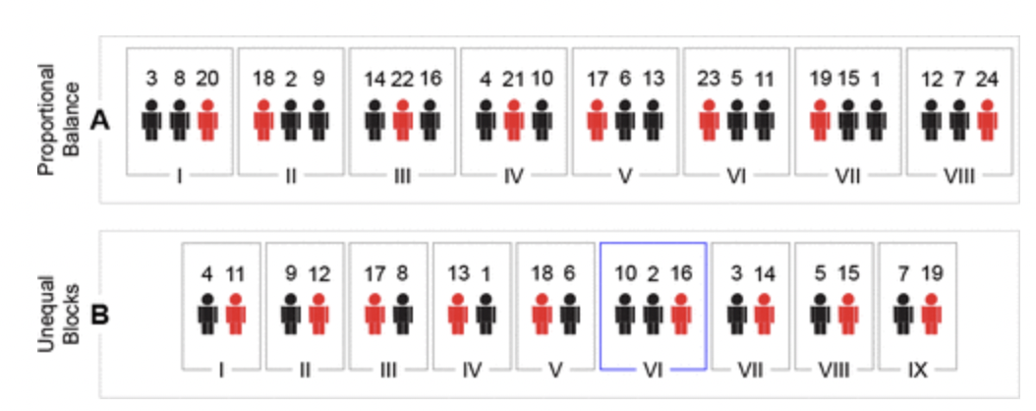
Randomized block design III: equal/unequal
Black: subjects 1–16 Placebo
Red: subjects 17–24 Treatment
Black: subjects 1–10 Placebo
Red: subjects 11–19 Treatment
https://pubs.acs.org/doi/10.1021/acs.jproteome.0c00536

Slide 62
“Block what you can control; randomize what you cannot control”
Notes:
The general rule is: "Block what you can, randomize what you cannot." Blocking is used to remove the effects of a few of the most important nuisance variables. Randomization is then used to reduce the contaminating effects of the remaining nuisance variables.

Slide 63
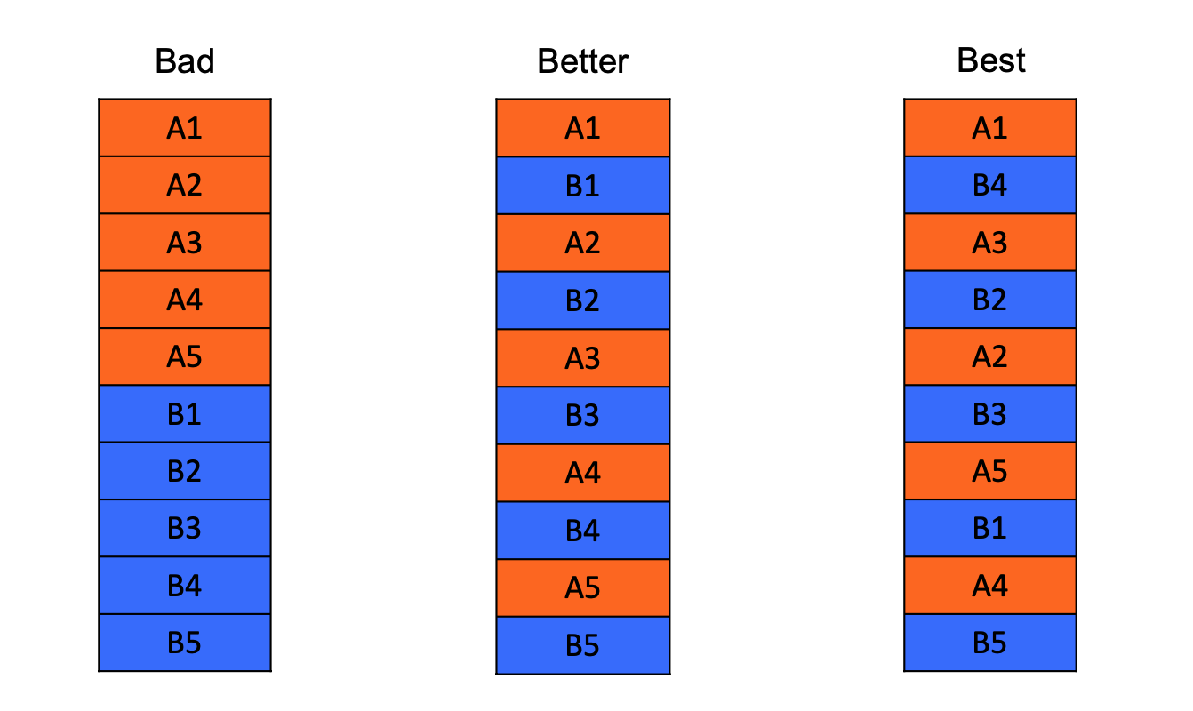
Good vs Bad experimental design
The default analysis assumes the data have come from a completely randomized design.
In practice, this is often a false assumption.
Solveig Mjelstad Olafsrud, Oslo University Hospital
Randomization
Notes:
https://www.fiosgenomics.com/experimental-design/
Control for systematic bias (error):
Distribute the biological groups systematically in a balanced fashion: for two groups of equal size, every second from each group
Divide it into roughly equal size batches limited by your capacity for the step
Tip: colour code the sample names by biological group and the column next to it by batch
Randomization and balancing with respect to biology of interest: Possible to separate technical variation from biological variation

Slide 64
Poll
 | Design 1 – Sample prep date | Design 2 – Sample prep date
Sample_1_E9.5 | Jan 9th, 2019 | Jan 11th, 2019
Sample_2_E9.5 | Jan 9th, 2019 | Jan 9th, 2019
Sample_3_E9.5 | Jan 9th, 2019 | Jan 11th, 2019
Sample_4_E9.5 | Jan 9th, 2019 | Jan 9th, 2019
Sample_1_E11.5 | Jan 11th, 2019 | Jan 11th, 2019
Sample_2_E11.5 | Jan 11th, 2019 | Jan 9th, 2019
Sample_3_E11.5 | Jan 11th, 2019 | Jan 11th, 2019
Sample_4_E11.5 | Jan 11th, 2019 | Jan 9th, 2019
Which is better design?
1) Design 1
2) Design 2

Slide 65
Poll
 | Design 1 – Gender | Design 2 - Gender
Sample_1_E9.5 | Male | Male
Sample_2_E9.5 | Male | Female
Sample_3_E9.5 | Male | Male
Sample_4_E9.5 | Male | Female
Sample_1_E11.5 | Female | Male
Sample_2_E11.5 | Female | Female
Sample_3_E11.5 | Female | Male
Sample_4_E11.5 | Female | Female
Which is better design?
1) Design 1
2) Design 2

Slide 66
Between-subjects vs within subjects design
In a between-subjects design (or between-groups design)
- every experimental unit experiences only one condition,
- group differences between participants in various conditions
Also called independent measures or independent-groups design because compare unrelated measurements taken from separate groups.

Slide 67
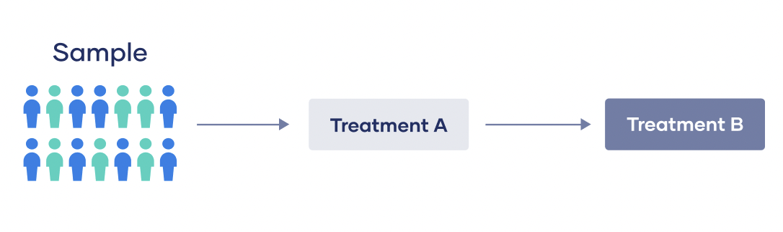
Between-subjects vs within subjects design
In a within-subjects design (or between-groups design)
- every experimental unit experiences all the conditions,
test the same individuals repeatedly to assess differences between conditions
Also called a dependent groups or repeated measures design because compare related measures from the same individuals between different conditions.
LMM workshop – April 2023

Slide 68
8. Bad design introducing batch effects

Slide 69
Genotype and development time effect on gene expression

Slide 70
Litter effect dominates the variation

Slide 71
Confounding in scRNA-seq data is a problem
Hicks, S. C., Townes, F. W., Teng, M. & Irizarry, R. A. Missing data and technical variability in single-cell
RNA-sequencing experiments. Preprint available from:https://doi.org/10.1093/biostatistics/kxx053 (2017).

Slide 72
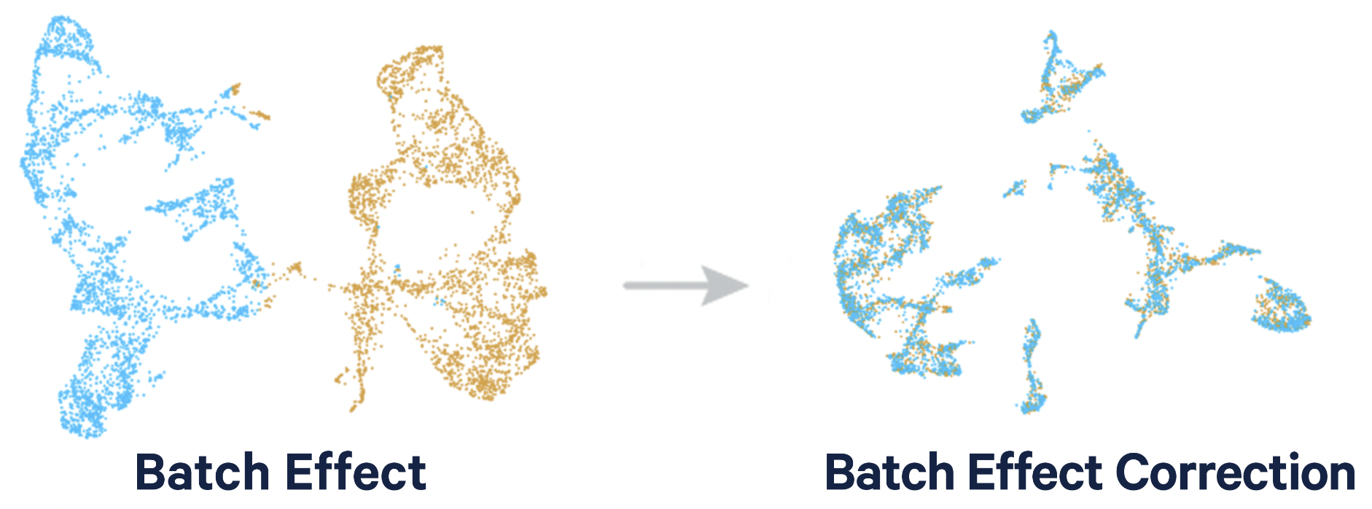
Confounding in scRNA-seq data is a problem

Slide 73
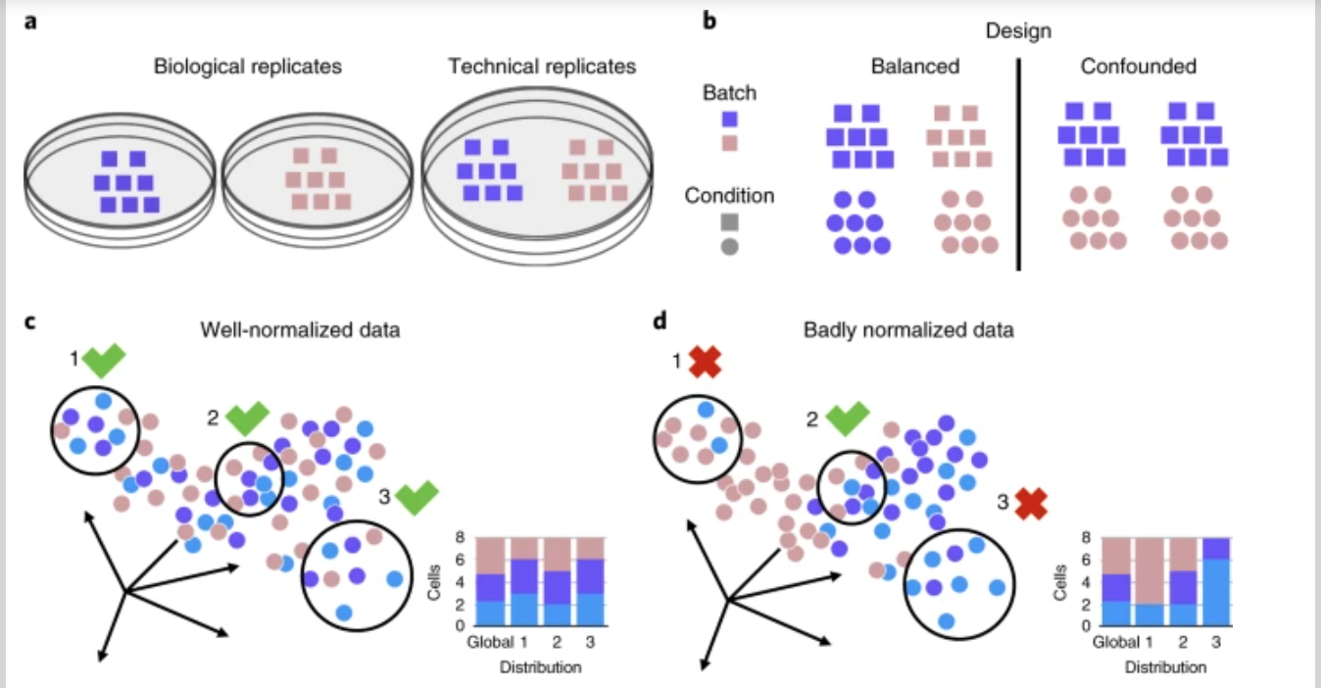
Well and badly analyzed scRNA-seq data
https://www.nature.com/articles/s41592-018-0254-1

Slide 74
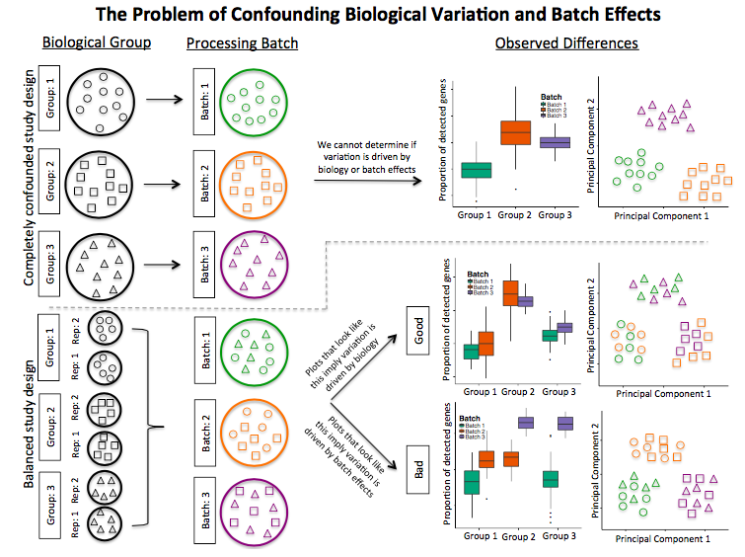
Confounding biological variation and batch effects

Slide 75
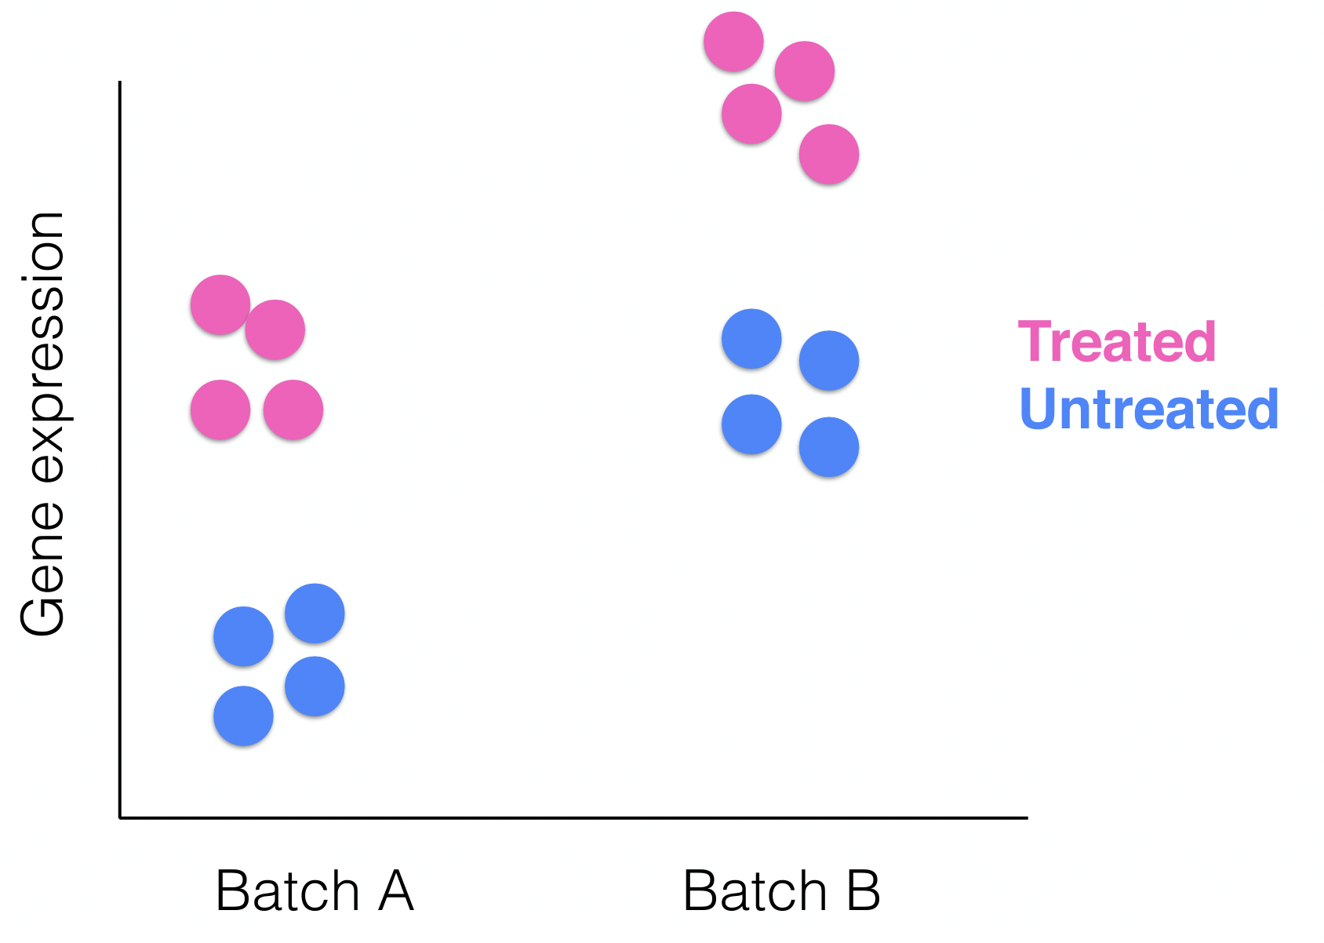
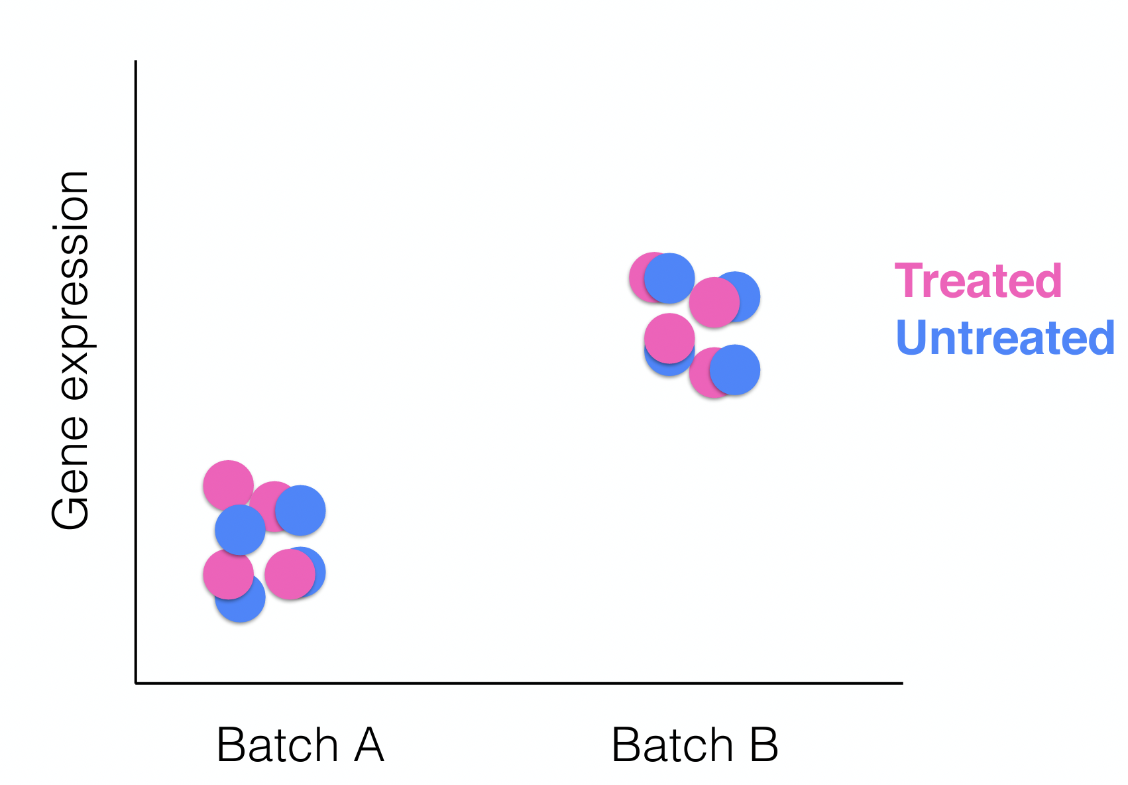
Non confounding experiments – no batch effects

Slide 76
Hot to know whether you have batches
Were all RNA isolations performed on the same day?
Were all library preparations performed on the same day?
Did the same person perform the RNA isolation/library preparation for all samples?
Did you use the same reagents for all samples?
Did you perform the RNA isolation/library preparation in the same location?
If any of the answers is ‘No’, then you have batches.

Slide 77
Isolate batch effects for RNA-seq
If unable to avoid batches:
Split replicates of the different sample groups across batches.
The more replicates the better (definitely more than 2).
Include batch information in your experimental metadata.
During the analysis regress out the variation due to batch if not confounded so it doesn’t affect the results.
scRNA-seq workshop – January 26th-27th focusing on batch effect day 2

Slide 78
Experimental design allow you to:
(1) choose an experimental design that is appropriate for the research problem at hand
(2) construct the design (performing randomization and determining the number of replicates)
(3) execute the plan to collect the data (or advise a colleague on how to do it)
(4) determine the model appropriate for the data
(5) fit the model to the data
(6) interpret the data and present the results in a meaningful way to answer the research question

Slide 79
Take – home messages
Plan ahead
Prevent bias from uncontrollable
Randomization and balancing
Write it down in an Experimental plan
Follow the experimental plan
Be careful with interpretation of results!
Notes:
Suggested reading: Stephen M.. 2016. Seven Pillars of Statistical Wisdom. Harvard University Press

Slide 80
Upcoming workshop at Gladstone:
Winter series
January 26-27 | Single Cell RNA-seq analysis
February 7 | Introduction to Pathway Analysis
February 9-10 | Single-Cell ATAC-Seq Data Analysis Part 1
February 17 | Introduction to Cytoscape and Network Biology
February 23 | Single-Cell ATAC-Seq Data Analysis Part 2
March 9 | Intermediate Cytoscape Networks and Omics Data Visualization

Slide 81
For questions:
michela.traglia@gladstone.ucsf.edu
reuben.thomas@gladstone.ucsf.edu
Slack: #questionsforbioinformaticscore
Thank you!
Please take the survey:
https://www.surveymonkey.com/r/DY7K5ZY

